Slide 1
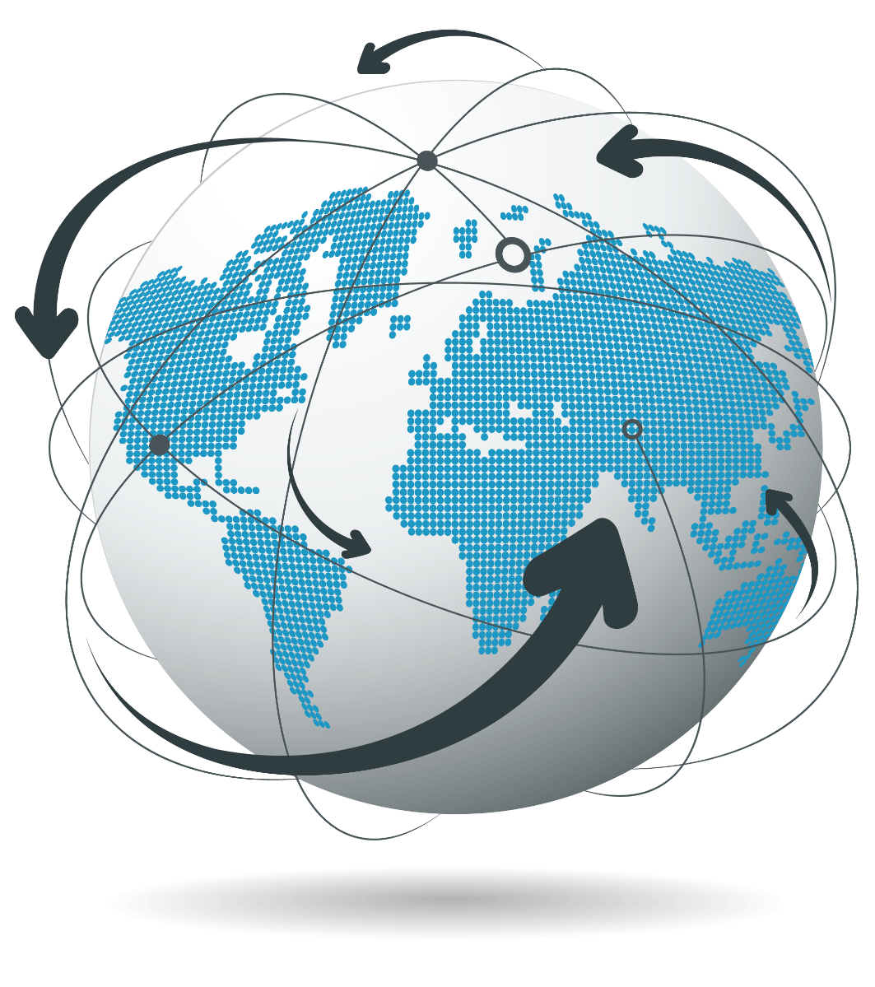

WELCOME TO
LIFE IS SUPER
www.superlifeworld.com
Est 2017

Slide 2


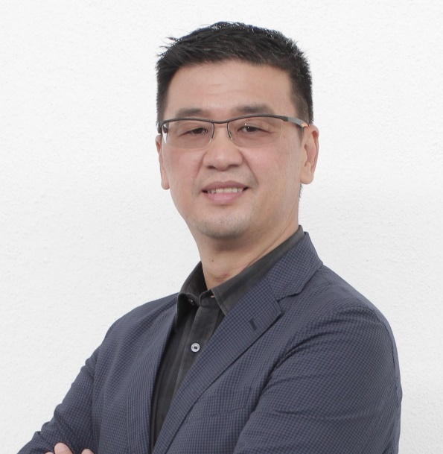
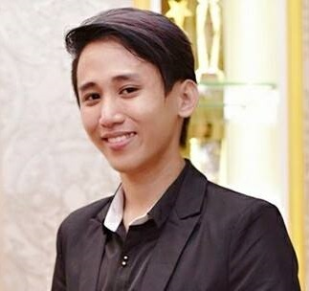
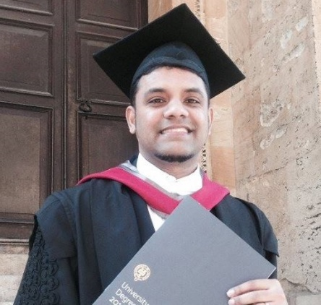
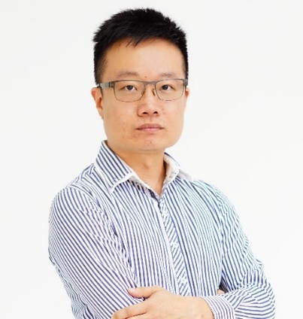
Our Founders:
Paul
CEO/FOUNDER
Top Management
of MNC
“OXFORD MBA”
Harry
CEO/FOUNDER
“Startup Mentor”
SPECIAL
ENTREPRENEUR
Leo
CEO/FOUNDER
“Tech Expert”
MARKETING
ADVOSOR
Lai Tek Kean (Ken)
CEO/FOUNDER
“The Million Dollar
Record breaker”

Slide 3

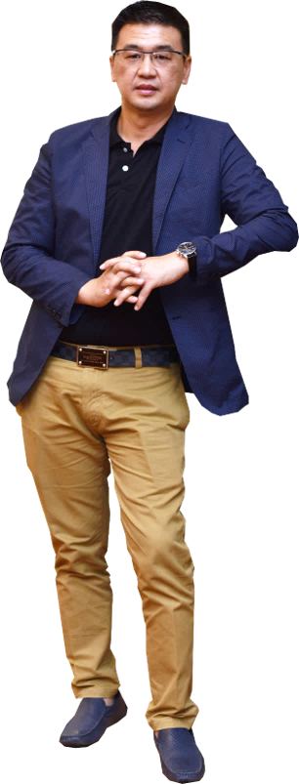
Lai Tek Kean (ken)
C.e.o/founder
www.superlifeworld.com
PERSONAL ACHIEVEMENTS
TODATE
GRADUATE OF MALAYSIA NATIONAL UNIVERSITY (UKM)
25 YEARS IN FINANCIAL PLANNING INDUSTRY
(MDRT & TOP AGENCY MANAGER)
ACHIEVED USD 1.2 MILLION DOLLAR INCOME FIRST YEAR IN NETWORK MARKETING INDUSTRY
BUILT A STRONG TEAM IN MORE THAN 30 COUNTRIES IN LESS THAN 3 YEARS

Slide 4


SUPERLIFE GLOBAL EXPANSION
UNITED STATES
KOREA
UNITED KINGDOM
MONGOLIA
JORDAN
UAE
HONG KONG
CHINA
MEXICO
ALGERIA
MOROCCO
THAILAND
NIGERIA
GHANA
PHILLIPINES
CAMEROON
MALAYSIA
UGANDA
TANZANIA
INDONESIA
BRAZIL
ZIMBABWE
SOUTH AFRICA
LA REUNION
AUSTRALIA
SUPER LIFE IN MORE THAN 57 COUNTRIES IN THE FIRST YEAR

Slide 5
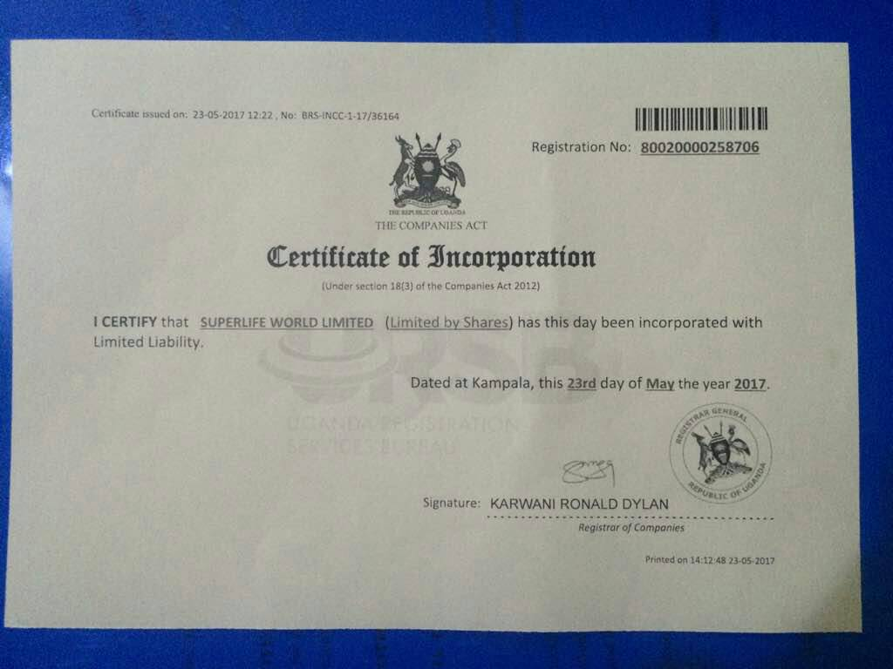

Slide 6

our mission
To improve the health and well-being of nations through the delivery of scientifically tested and clinically proven products

Slide 7
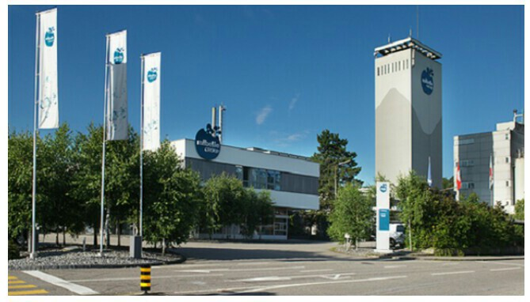
What We Do?
We are in Health and Wellness industry
In partnership with Mibble Biochemistry

Slide 8
www.superlifeworld.com
www.superlifeworld.com
SUPERLIFE
PRODUCTS
SHOW CASE
LIFE IS SUPER!

Slide 9

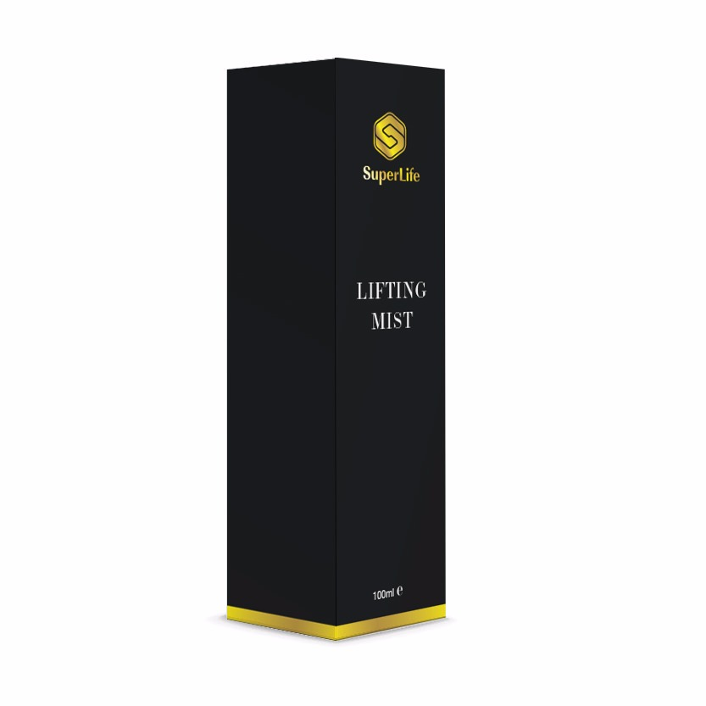
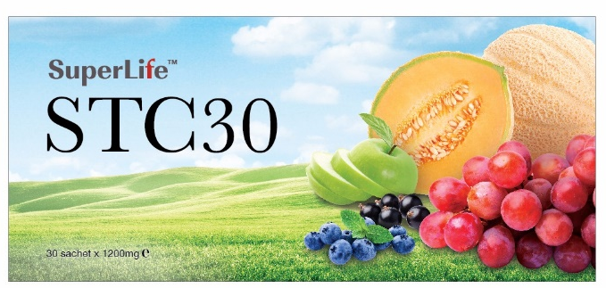

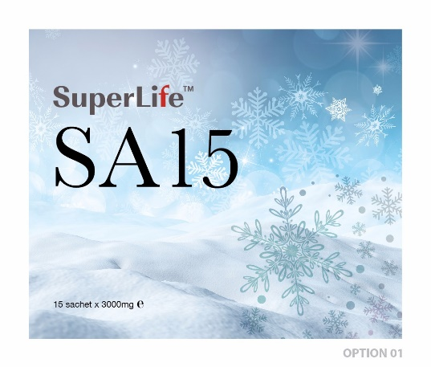
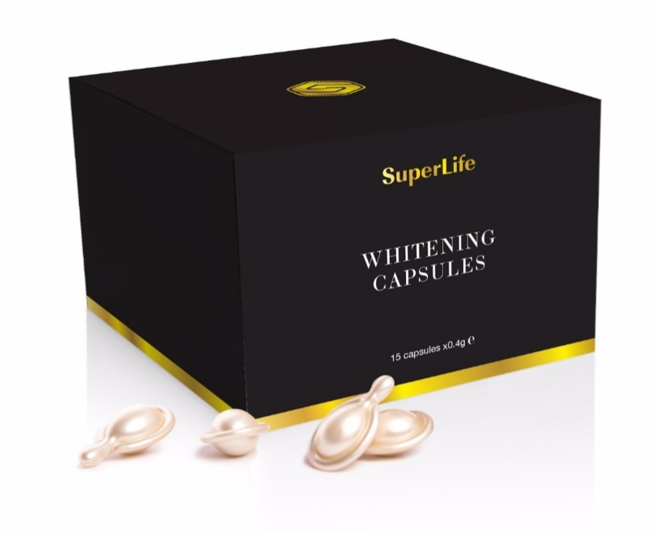
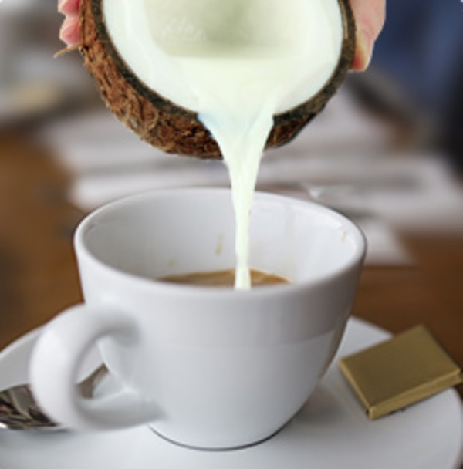
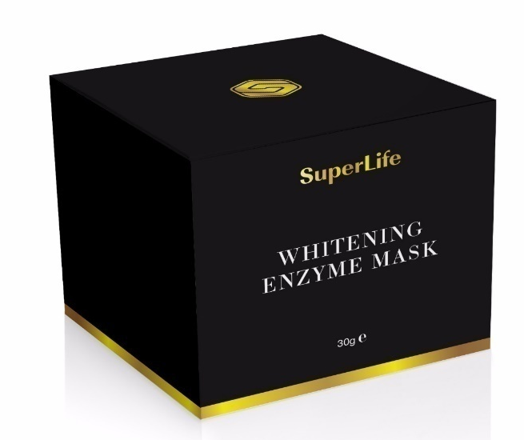
OUR products
SLIMING SERIES
COCONUT COFFEE

Slide 10

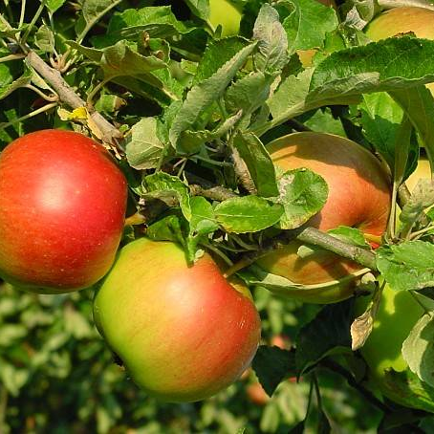
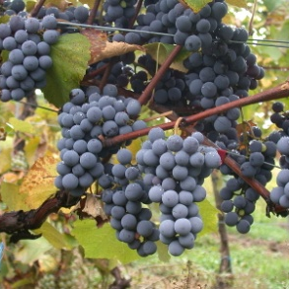
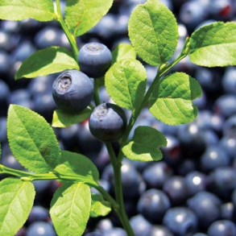
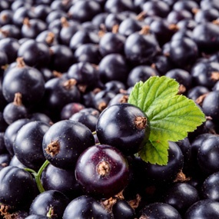
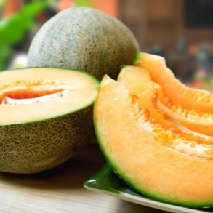

Key active ingredients
30 DAYS OF TRANSFORMATION
ATWILER SPATULAUBER
Revolutionary anti-aging performance for real rejuvenation
VITIS VINIFERA
Protects and maintains epidermal stem cells from UV
BILBERRY
Improves eyesight, and treats cataract, CFS, hemorrhoids, diabetes, osteoarthritis, gout, skin infections and kidney
Blackcurrant
improves blood flow, immune system, eye health, gut health and kidney health
GliSODin®
CANTALOUPE
Prevents cancer, improves immune system, skin health, eye, diabetes, and arthritis
GliSODin®
GLIADIN
Promotes the body’s natural antioxidant system, improves skin and immune system

Slide 11
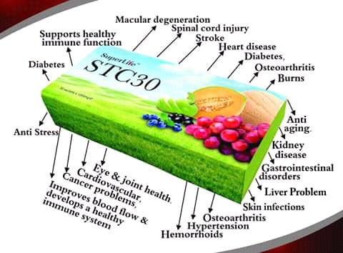
BENEFITS OF STC30

Slide 12

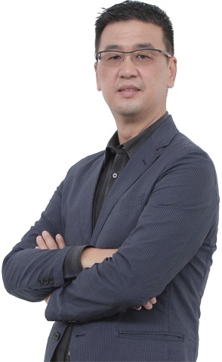
SUPERLIFEBUSINESS OPPOTUNITY
www.superlifeworld.com
LIFE IS SUPER
COMPENSATION PLAN

Slide 13
HOW DO YOU JOIN SUPERLIFE
BUSINESS OPPORTUNITY?

Slide 14


THE NEW SUPERLIFE DISTRIBUTORS’ PACK:
4 TYPES OF PACKAGES
 | PACKAGE | STC30 boxes | AMOUNT (UGX)
 | STARTER | 1 | 300,000
 | STAR | 2 | 500,000
 | SUPREME | 8 | 1,860,000
 | SUPER | 20 | 4,700,000
ALL PRICES IN THIS PRESENTATION INCLUDE 10% SHIPPING, CUSTOM CLEARING, ADMINISTRATIVE AND HANDLING CHARGES

Slide 15
SIX WAYS OF EARNING
www.superlifeworld.com
www.superlifeworld.com
www.superlifeworld.com
www.superlifeworld.com
www.superlifeworld.com
Retail (30% to 40% discount)
2. Direct Referral Bonus (DRB)
3. Double Development Bonus (DDB)
4. Key in Bonus
5. Roll Up Bonus
6. Uni-level Bonus

Slide 16
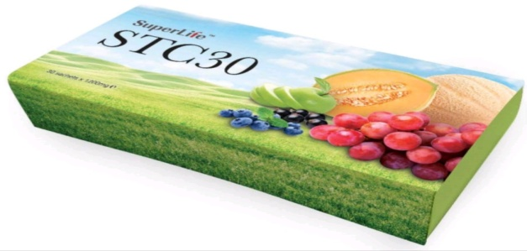
www.superlifeworld.com
Retail (30% to 40% discount)
Buy 1STC30 UGX. 300,000
Sell. 350,000
Profit. UGX 50,000

Slide 17
2. DIRECT REFERRAL BONUS (DRB) OF THE
STARTER PACKACES
  Starting capital:
  UGX. 300,000
YOU
LEFT
RIGHT
UGX 50,000
UGX 50,000
RUTH
ALEX
STARTER
STARTER

Slide 18


3. Double Development Bonus
LEFT
YOU
RIGHT
UGX 50,000
UGX 50,000
36,000
UGX 50,000
UGX 50,000
UGX 50,000
UGX 50,000
36,000
36,000
103,600
103,600
36,000
36,000
36,000
36,000
36,000
36,000
36,000
36,000
36,000
36,000

Slide 19
star PACKAGE:
STAR
  Starting capital:
  Shs. 500,000
120,000
120,000
72,000
STAR
STAR
TOTAL=312,000
STAR
STAR
STAR
STAR
72,000
72,000

Slide 20
SUPREME PACKAGE
  Starting capital:
  Shs 1,860,000
SUPREME
560,000
560,000
SUPREME
SUPREME
TOTAL=1,408,000
288,000
SUPREME
SUPREME
SUPREME
SUPREME
288,000
288,000

Slide 21
super PACKAGE:
SUPER
  Starting capital:
  Shs 4,700,000
1,400,000
1,400,000
SUPER
SUPER
TOTAL=3,520,000
720,000
SUPER
SUPER
SUPER
SUPER
720,000
720,000

Slide 22



ONE YEAR STARTER PACKAGE LAZY SCENARIO
YOU
2
36,000ugx
2nd month
4
72,000ugx
3rd
8
133,200ugx
4th
16
288,000ugx
5th
32
532,800ugx
6th
64
1,065,600ugx
7th
128
2,131,200ugx
8th
256
4,262,400ugx
9th
512
8,524,800ugx
10th
1,024
17,049,600ugx
www.superlifeworld.com
11th
2,048
34,099,200ugx
LIFE IS SUPER
12th
4,096
68,198,400ugx
12 Months
8,000+ people
133,200,000ugx

Slide 23

DIRECT SPONSOR
STARTER PACKAGE – MAX 25% ON PP
www.superlifeworld.com
STARTER
300,000
STARTER
UGX 300,000
STAR
UGX 500,000
UGX 50,000
25% PP
SUPREME
UGX 1,860,000
SUPER
UGX 4,700,000
UGX 60,000
15% PP
UGX120,000
7.5% PP
UGX 160,000
4% PP
$1100
SUPER
$12.50
25% PP
$15.00
15% PP
$30.00
7.5% PP
$40.00
4% PP

Slide 24
DIRECT SPONSOR
STAR PACKAGE – MAX 30% ON PP
www.superlifeworld.com
STAR
UGX 500,000
STARTER
UGX 300,000
UGX 60,000
30% PP
STAR
UGX 500,000
SUPREME
UGX 1,860,000
SUPER
UGX 4,700,000
UGX120,000
30% PP
UGX 240,000
15%PP
UGX 320,000
8% PP
$1100
SUPER
$12.50
25% PP
$15.00
15% PP
$30.00
7.5% PP
$40.00
4% PP

Slide 25
DIRECT SPONSOR
SUPREME PACKAGE – MAX 35% ON PP
www.superlifeworld.com
SUPREME
UGX1,860,000
STARTER
UGX 300,000
UGX 60,000
30% PP
STAR
UGX 500,000
SUPREME
UGX 1,860,000
SUPER
UGX 4,700,000
UGX120,000
30% PP
UGX 560,000
35% PP
UGX 640,000
16% PP
$30.00
7.5% PP
$40.00
4% PP

Slide 26
DIRECT SPONSOR
SUPER PACKAGE – MAX 35% ON PP
www.superlifeworld.com
SUPER
UGX 4,700,000
STARTER
UGX 300,000
UGX 60,000
30% PP
STAR
UGX 500,000
SUPREME
UGX 1,860,000
SUPER
UGX 4,700,000
UGX120,000
30% PP
UGX 560,000
35% PP
UGX 1,400,000
35% PP
$40.00
4% PP

Slide 27
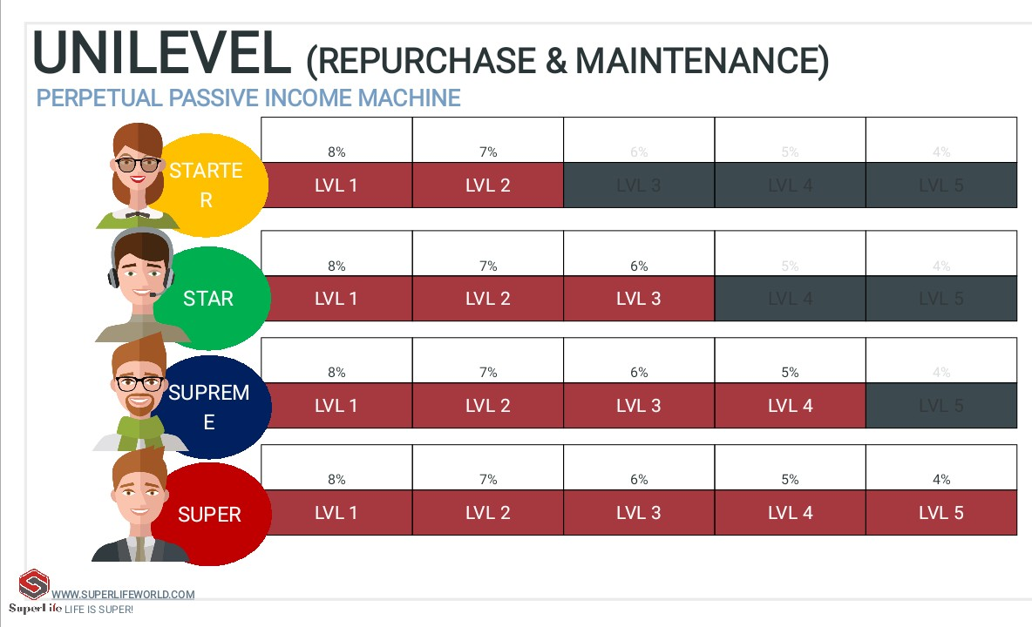

Slide 28
